Slide 1
Lecture 5
Physics of Welding Arc I

Slide 2
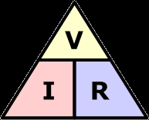
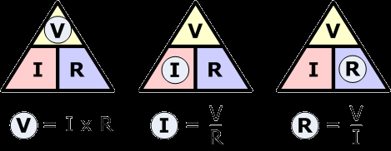

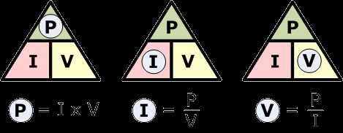
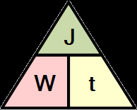
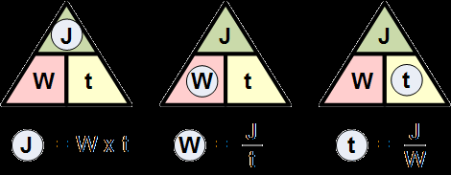
Ohms Law Triangles

Slide 3
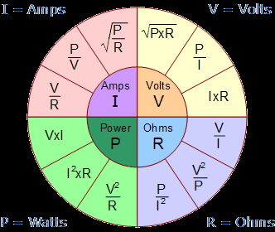
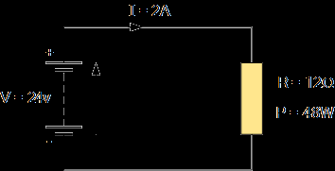
Ohms Law Pie Chart

Slide 4
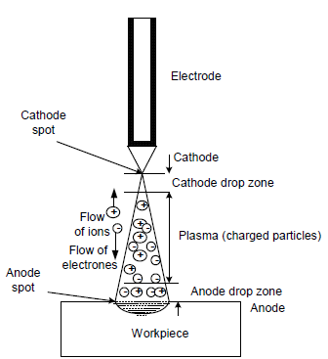
Introduction
Flow of current from cathode to anode through the gap between electrode and work piece to produce the welding arc, needs column of charged particles
Density of charged particles in gap
governs the electrical conductivity
of gaseous column
Electrons released from cathode (due to electric field or thermo-ionic emission) are accelerated towards the anode because of potential difference between work piece and electrode.

Slide 5
Introduction
These electrons collide with gaseous molecules an decompose them into charged particles i.e.
(electrons move towards work Piece and
ions move towards electrode to form a
part of welding current).
Ion current becomes only about 1% of electron current because ions heavier than the electrons so they move slowly.
Eventually electrons merge into anode and arc gap between electrode and work piece acts as pure resistance load.
Heat generated in a welding arc depends on arc voltage and welding current.(P=V x I)

Slide 6
Emission of Free electrons
Free electrons and charged particles are needed between the electrode and work for initiating the arc and their maintenance.
-Ease of emitting electrons by a material assessed by two parameters:
1.Work function or
2.Ionization potential.
-Work function is the energy in (e v or J) required to get one electron released from the surface of material

Slide 7
Emission of Free electrons
Ionization potential is another measure of ability of a metal to emit the electrons. It is the energy/unit charge (v) required for removing an electron from an atom.
Ionization potential is different for different metal, e.g., Ca, K, and Na is (2.1-2.3ev), while for Al and Fe is 4 and 4.5 ev respectively.
The mechanisms through which free electrons are emitted during arc welding are:
1.Thermal emission (thermo-ionic emission )
2. Field emission
3.Secondary emission .

Slide 8
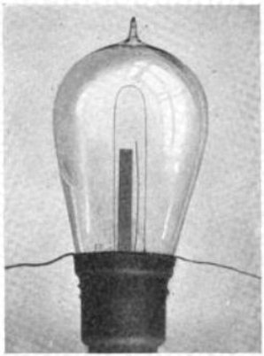
Thermal emission
-Thermally induced flow of electron from a surface because the thermal energy given to the surface overcomes the work function of the material
-The mechanism of emission of electron due to
heating of metal is called thermo- ionic emission
-Increase in temperature of metal(T)
increases the kinetic energy(MV²) of free
electrons and as it goes beyond certain limit,
electrons are ejected from the metal surface
-The temperature at which thermo-ionic emission takes place, most of the metals melt. Hence, refractory materials like tungsten and carbon, having high melting point exhibit thermo-ionic electron emission tendency.

Slide 9
Field Electron Emission:
-In this approach high strength electro-magnetic field that generated during thermal emission process, leads to free electrons pull out of the metal surface .
-High potential difference(107 V/cm) between
the work piece and electrodes established
(to overcome the work function) for the field
electron emission purpose.

Slide 10
Secondary Electron Emission
High velocity electrons moving from cathode to anode in the arc gap collide with other gaseous molecules.
This collision results in decomposition of gaseous molecules into atoms and charged particles (electrons and ions).

Slide 11
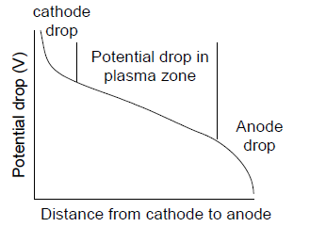
Zones in Arc Gap
On establishing the welding arc, drop in arc voltage is observed across the arc gap.
The rate of drop in arc voltage varies with distance from the electrode tip to the weld pool
Generally, five different zones
are observed in the arc gap:
Cathode spot,
Cathode drop zone,
Plasma,
Anode drop zone and
Anode spot

Slide 12
Cathode spot
-This is a region of cathode where from electrons are emitted. -There are three types of cathode spots :
1.mobile, 2. pointed, and 3.normal.
-There can be one or more than
one cathode spots moving at high speed
ranging from 5-10 m/sec.
-Mobile cathode spot is usually produced at current density 100-1000 A/mm2. it is generally found during the welding of aluminum and magnesium.

Slide 13
Cathode spot
Mobile cathode spot loosens the oxide layer on reactive metal like aluminum, Mg and stainless steel. Therefore, mobile cathode spot helps in cleaning action when reverse polarity is used i.e. work piece is cathode.
Pointed cathode spot is formed at a point only mostly in case of tungsten inert gas welding at about 100A/mm2. Pointed tungsten electrode forms the pointed cathode-spot.
Coated steel electrode with ball shaped tip of forms normal cathode spot.

Slide 14
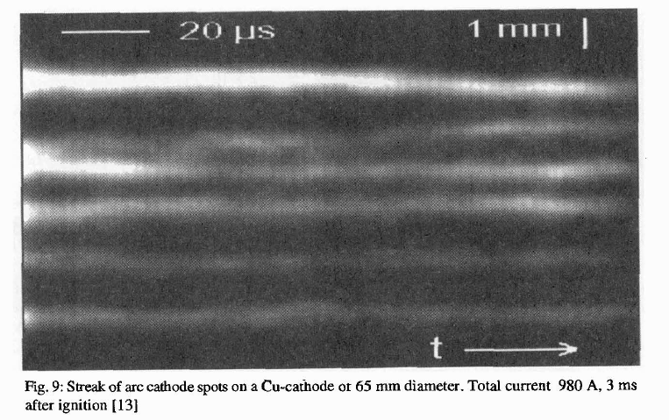
Cathode Spot

Slide 15
Cathode drop region:
-This region is very close to the cathode
and a very sharp drop of voltage takes
place in this zone
-Due to cooling effect of cathode voltage
drop in this region directly affects the
heat generation near the cathode which
in turn governs melting rate of the electrode
in case of the consumable arc welding process
with straight polarity (electrode is cathode).

Slide 16
Plasma
Plasma is the region between electrode and work where mostly flow of charged particles namely free electrons and positive ions takes place.
In this region, uniform voltage drop takes place. Heat generated in this region has minor effect on melting of the work piece and electrode.

Slide 17
Anode drop region:
Like cathode drop region, anode drop region is also very close to the anode and a very sharp drop in voltage takes place in this region due to cooling effect of the anode voltage drop in this region.
Thus voltage drop in this region affects the heat generation near the anode & so melting of anode.
In case of direct current electrode negative (DCEN), voltage drop in this zone affects melting of the work piece.

Slide 18
Anode spot:
Anode spot is the region of a anode where electrons get merged and their impact generates heat for melting.
However, no fixed anode spot is
generally noticed on the anode like
cathode spot.

Slide 19
Electrical Fundamentals of Welding Arc
The welding arc acts as impedance for flow of current like an electric conductor.
The impedance function (Temp., 1/density of charge particles and their mobility) .
Therefore, distribution of charged particles in radial and axial direction in the arc affects the total impedance of the arc

Slide 20
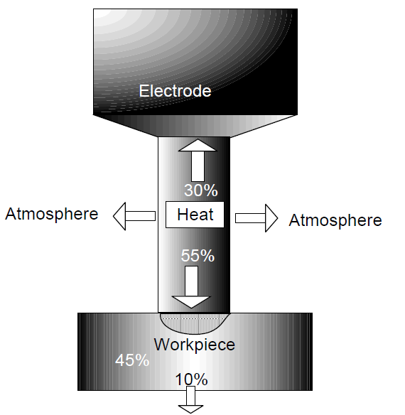

Slide 21
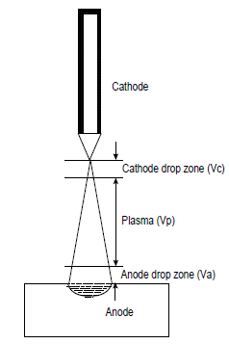
Electrical Fundamentals of Welding Arc
-The power of the arc( heat generation per unit time)= V X I
V is the arc voltage in volt (V), I is the
welding current in ampere (A)
and power of arc P is in watt (W).
-V is taken as sum of potential drop across:
- the cathode drop region (Vc),
-the plasma region (Vp), and
-anode drop region (Va)
-Thus power of the arc (P ) becomes
= (Vc + Vp + Va) X I …………………….5.1

Slide 22
Electrical Fundamentals of Welding Arc
-Equation 5.1 suggests that the distribution of heat in three zones cathode, anode and arc plasma can be changed, for example:
-Variation of arc length mainly affects plasma heat. Increase in spacing between the electrode and work-piece generally increases the potential of the arc because of increased losses of the charge carriers by radial migration to cool boundary of the plasma.
-Increase in the length of the arc column exposes more surface area of arc column to the low temperature atmospheric gas. To maintain the flow of current across the arc, the above losses of charged particles must be accommodated to stabilize the arc via increasing the applied voltage.
-Addition of low ionization potential materials (K potassium and Na) reduces the arc voltage because of increased ionization in arc gap so increased electrical conductivity which in turn reduces the heat generation in plasma region.

Slide 23
Electrical Fundamentals of Welding Arc
-Direct current electrode negative polarity (DCEN) or straight polarity. [Electrode( -) Workpiece (+)]
-Direct current electrode positive polarity (DCEP) or reverse polarity. [Electrode( +) Workpiece (-)]
-Heat generation at the anode and cathode drop zones is primarily governed by type of welding process and polarity associated with welding arc.
-The submerged arc welding with DCEP generates larger amount of heat at cathode than anode as indicated by high melting rate of consumable electrode.

Slide 24
Electrical Fundamentals of Welding Arc
-The most of the heat generated in consumable arc welding process goes to weld pool, thus the thermal efficiency of metal arc welding processes is found in range of 70-80% whereas that for non-consumable arc welding processes is found in range of 40-60%.
-Shielding gas also influences the heat generation in the cathode and anode drop zones.
-TIG welding with argon as shielding gas shows 8-10 time higher current carrying capacity (without melting) than DCEP.

